Slide 1
Student Portal
Presented by Shabbir Ahmed Shakib (142-35-664)

Slide 2
Features:
Teacher:
a. Add teacher info
b. Add student info
c. Add result
Student:
a. See result
b. See student info

Slide 3
MOTIVATION
Reduce paperwork and save time and money with mobile and cloud-based attendance management system
Eliminate duplicate data entry and errors in time and attendance entries
Improve visibility to track and manage student attendance & absenteeism across multiple campuses
Real-time status tracking of leave requests
Automatic calculation of leave and reward points accrued.

Slide 4
STEKHOLDERS OF THE PROJECT
1.Teacher
2.students

Slide 5
PLATFORM
Hardware Requirements
Processor- Pentium II or higher
RAM- 64 Mb or higher
Hard Disk Space- 128 Mb or higher
Software Requirements
Operating System- For user no specific OS is required. The server machine must have Windows 7/8/8.1/10 along with SQL server.
Language- Dot net
Database- SQL server

Slide 6
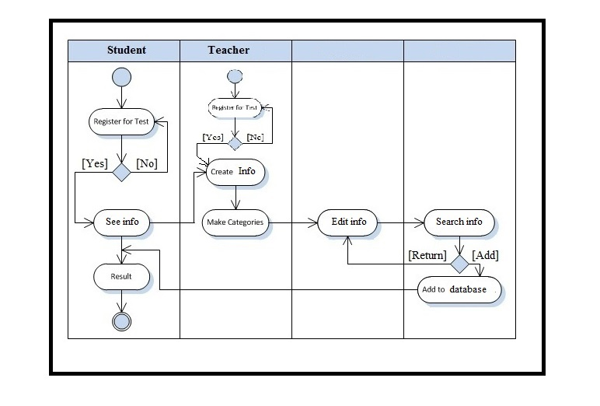
SYSTEM FLOW

Slide 7
PROJECT TASK
Task | Person | Start Date | End Date
Requirement Collection | Shabbir Ahmed Shakib | 09-11-2017 | 10-11-2017
Database Design | Shabbir Ahmed Shakib | 20-11-2017 | 22-11-2017
System Design | Shabbir Ahmed Shakib | 23-11-2017 | 25-11-2017
Coding | Shabbir Ahmed Shakib | 26-11-2017 | 30-11-2017
Testing | Shabbir Ahmed Shakib | 01-12-2017 | 08-12-2017
Delivery | Shabbir Ahmed Shakib | 09-12-2017 | 12-12-2017

Slide 8
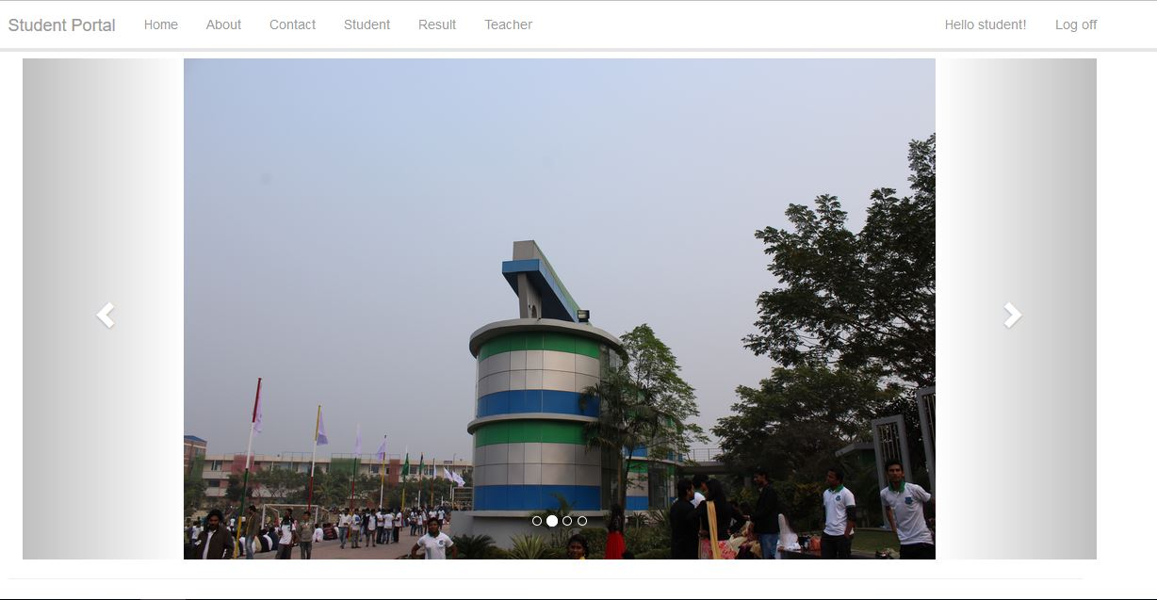
User Interface:

Slide 9
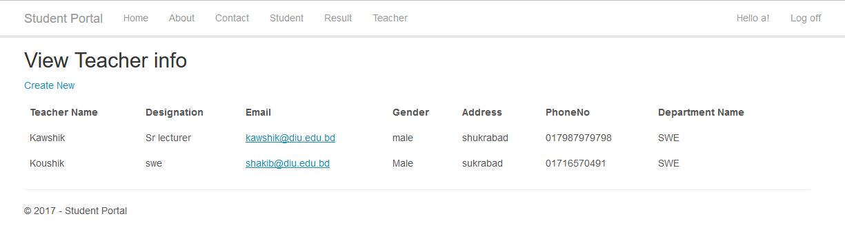
Login as a teacher:

Slide 10
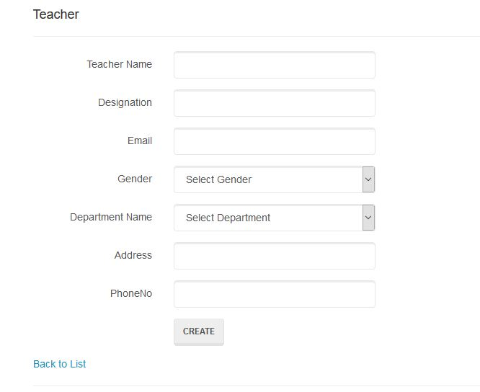

Slide 11
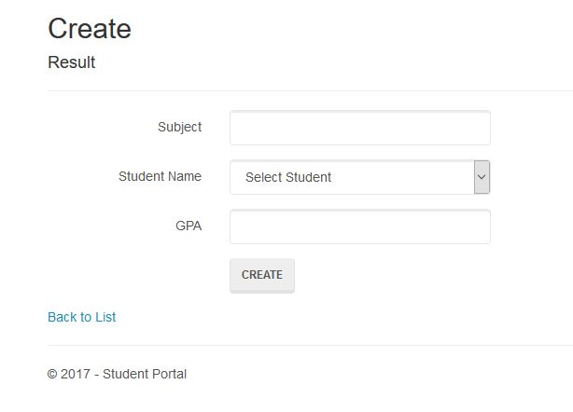

Slide 12
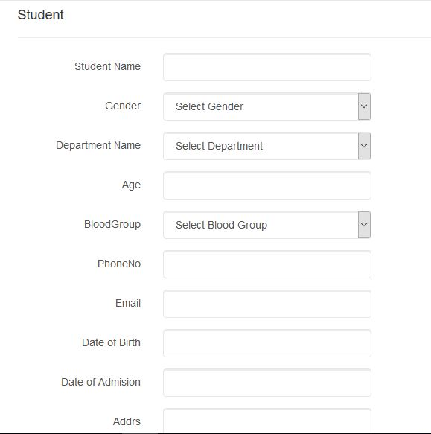

Slide 13
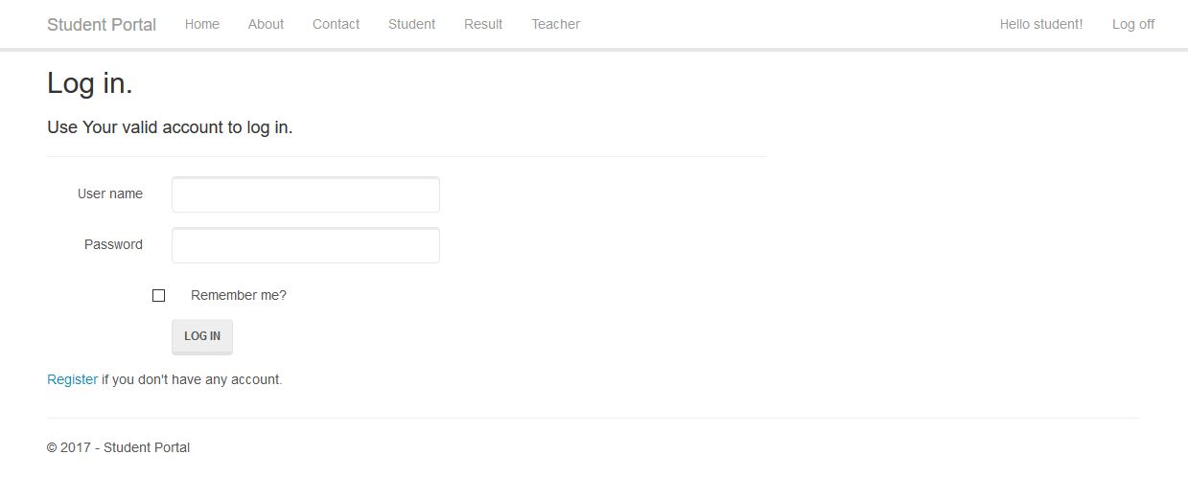
Login as a student:

Slide 14
THANK YOU

